Slide 1
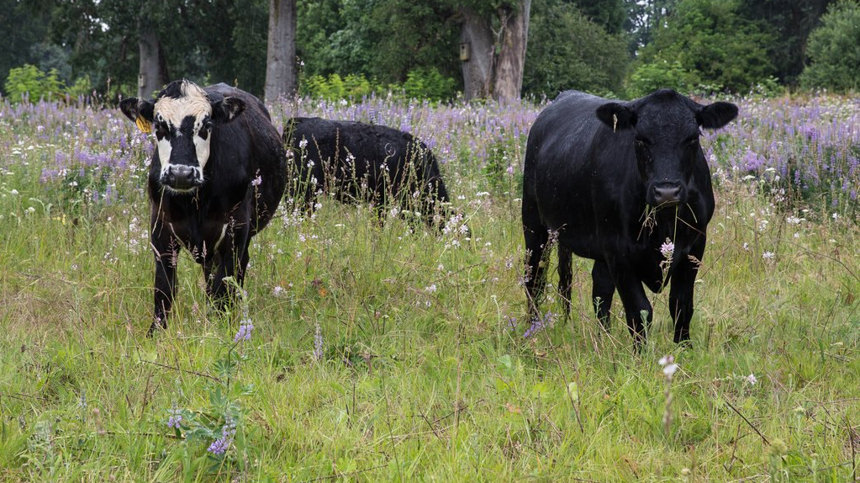
Livestock Grazing on Wetlands
Brooke Bennett, Alluvial Solutions
October 24, 2019

Slide 2
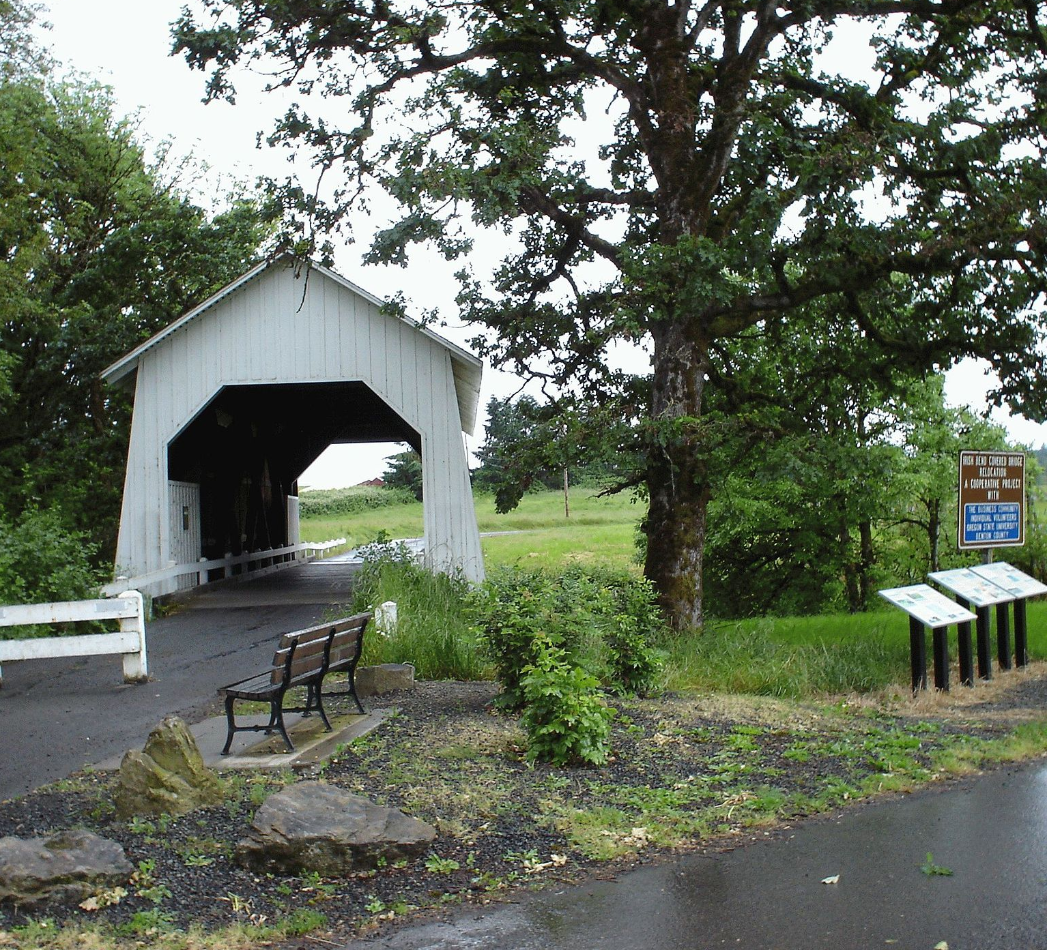
Restoring the Lamprey Creek wetlands

Slide 3
Key Engineering Issues
What land management tools are most effective for supporting livestock grazing?
How can we capture this in our designs and models?

Slide 4




GOALS
Impacts of grazing cattle on riparian areas
Strategies for mitigating negative effects
Benefits of livestock presence
Translate to design and model parameters

Slide 5
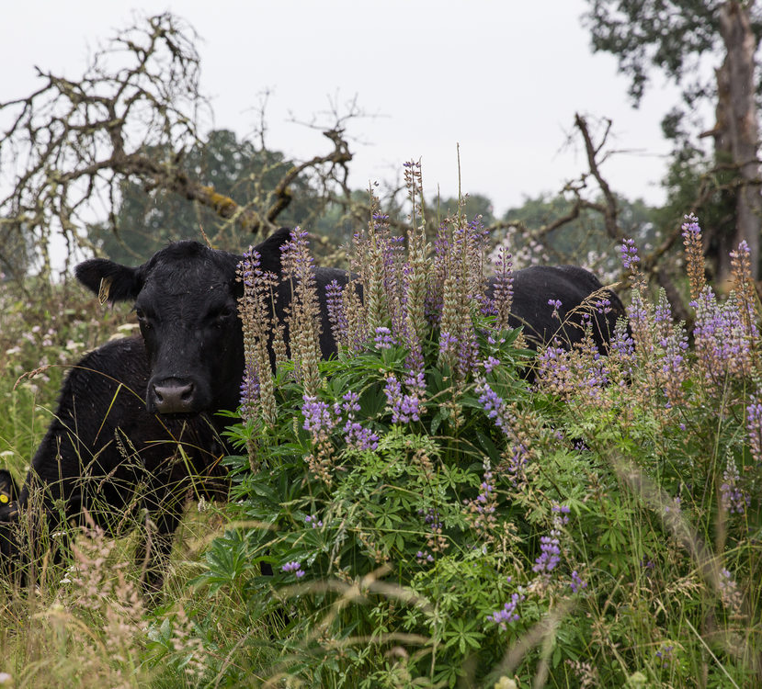
What are known impacts of cattle grazing?
Disturbance
Control of exotic or aggressive species
Trampling/grazing
Support of native species
Opening ecological niches
Increase below-ground organic matter

Slide 6
Goals
✓
Impacts of grazing cattle on riparian areas

Slide 7
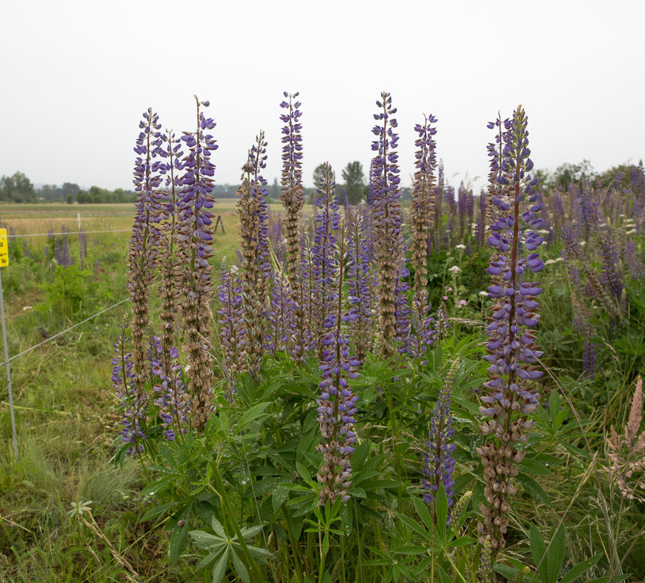
What benefits do we care about?
Boosting the native species
Controlling invasives
Economic gain
Water, forage, cover

Slide 8
Goals
✓
Benefits of livestock presence

Slide 9
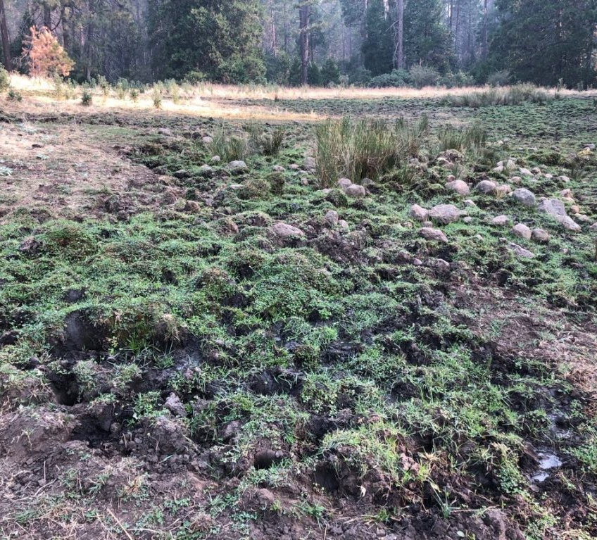
How can we mitigate the negative effects?
Light to moderate intensity
Seasonality
Fencing / rotation
“Limitation” – recharge plant growth, prevent soil compaction
Upland / lowland greening
Supplementary feed

Slide 10
Goals
✓
Strategies for mitigating negative effects

Slide 11
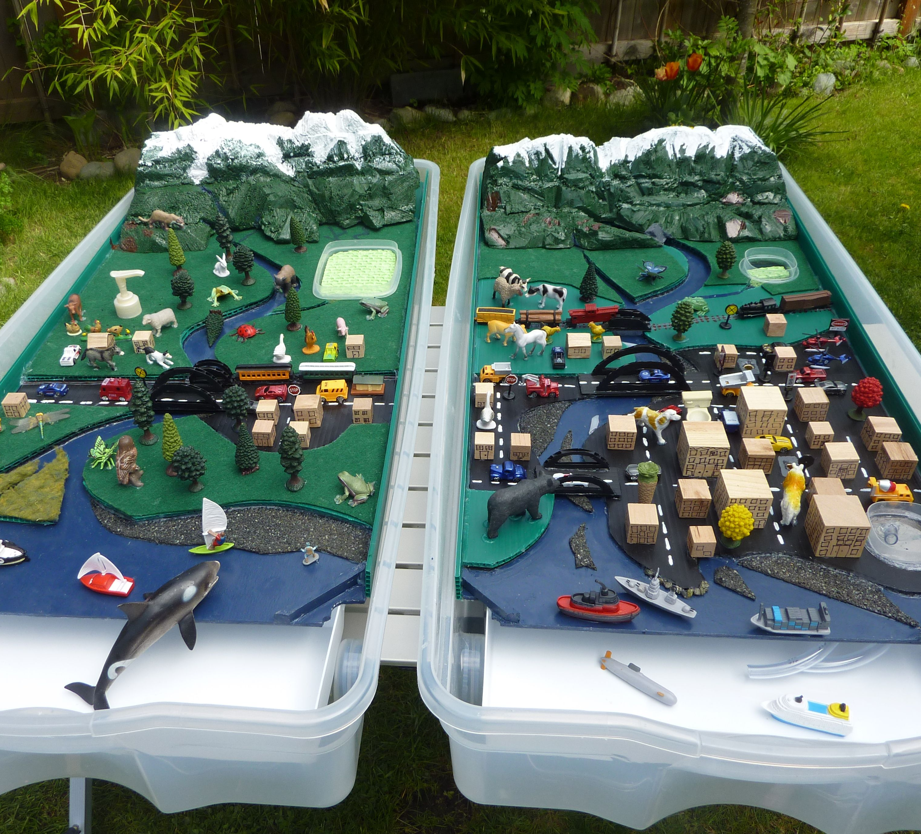
How can we capture this in our model?
Design alternatives
“Tuning” HEC-HMS model parameters

Slide 12
Goals
✓
Translate to design and model parameters

Slide 13
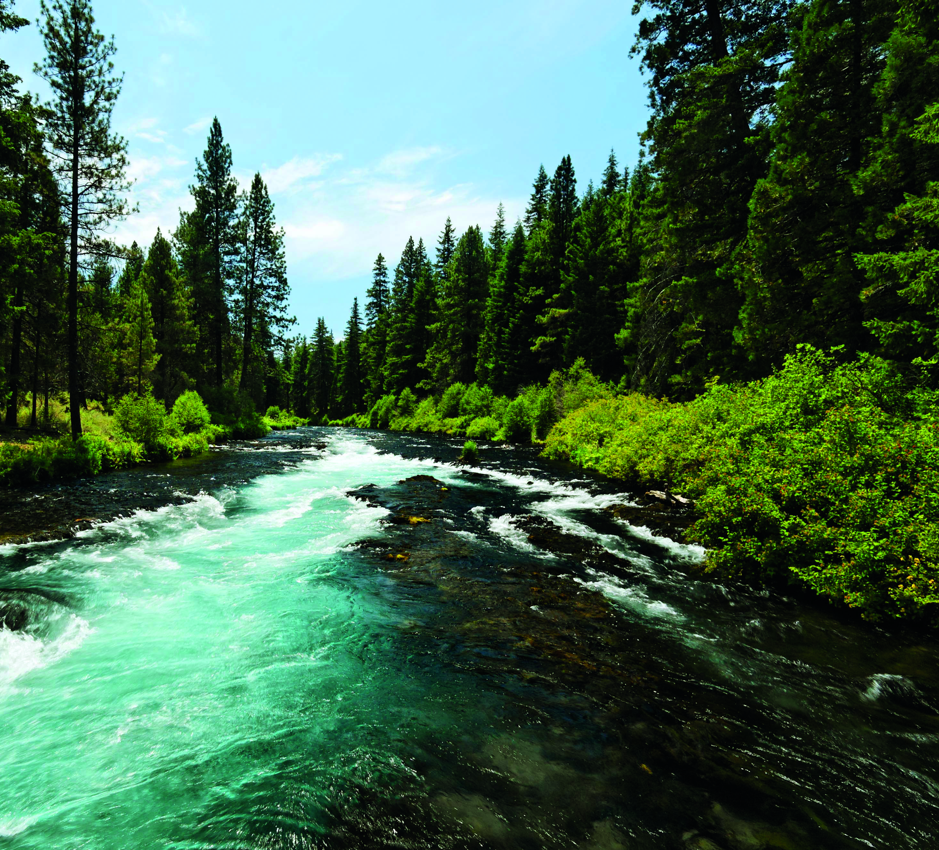
The Big Picture

Slide 14
Impacts of grazing cattle on riparian areas
Strategies for mitigating negative effects
GOALS
Benefits of livestock presence
Translate to parameters for modeling

Slide 15
Key Engineering Issues
What land management tools are most effective for supporting livestock grazing?
How can we capture this in our designs and models?

Slide 16
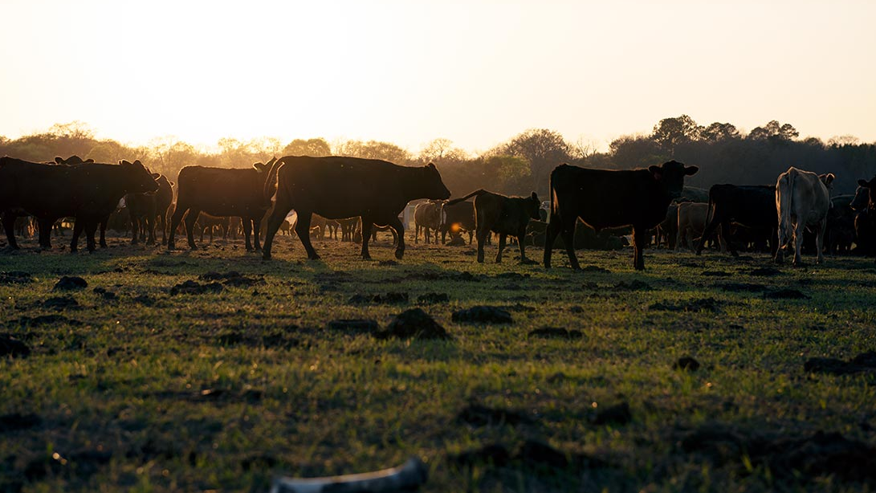
Questions and Feedback

